Slide 1


Project report Hostel Management
Submitted by : Krupal Patel (18171341093), Meet Patel (18171341096)
Parth Patel (18171341100), Pratham Patel (18171341102)
Neel Patel (18171341097)

Slide 2
Abstract
As the name specifies “HOSTEL MANAGEMENT SYSTEM” is a software developed for managing various activities in the hostel. For the past few years the number of educational institutions are increasing rapidly.
Thereby the number of hostels are also increasing for the accommodation of the students studying in this institution. And hence there is a lot of strain on the person who are running the hostel and software’s are not usually used in this context.
This particular project deals with the problems on managing a hostel and avoids the problems which occur when carried manually.

Slide 3
Tools
HTML : HTML (Hyper Text Markup Language) is the most basic building block of the Web. It defines the meaning and structure of web content. Other technologies besides HTML are generally used to describe a web page's appearance/presentation css. "Hypertext " refers to links that connect web pages to one another, either within
a single website or between websites. Links are a fundamental aspect of the Web. By
uploading content to the Internet and linking it to pages created by other people, you
become an active participant in the World Wide Web.
PHP : PHP is an acronym for “ PHP: Hypertext Preprocessor “. PHP is a widely-used, open source scripting language. PHP scripts are executed on the server.PHP is free to download and use.

Slide 4
Tools
3. CSS : CSS stands for Cascading Style Sheets. CSS describes how HTML elements
are to be displayed on screen, paper, or in other media. CSS saves a lot of work.
It can control the layout of multiple web pages all at once. External stylesheets
are stored in CSS files.
4. My SQL : MySQL is a fast, easy-to-use RDBMS being used for many small and big
businesses. MySQL is developed, marketed and supported by MySQL AB, which
is a Swedish company. MySQL is released under an open-source license. MySQL
works very quickly and works well even with large data sets. MySQL is very
friendly to PHP, the most appreciated language for web development.

Slide 5
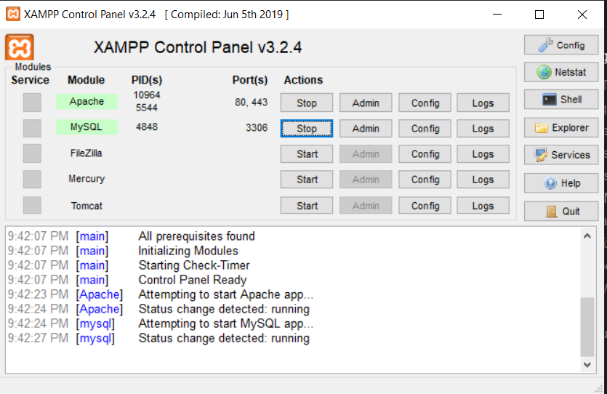
Tools
5. XAMPP : XAMPP is a free and open-source cross-platform web server solution stack
package developed by Apache Friends, consisting mainly of the Apache HTTP Server,
MariaDB database, and interpreters for scripts written in the PHP programming
languages.

Slide 6
User Requirements
- To gain access to the e-registration system, the user would need:
1. A personal computer
2. A username
3. A genuine password
User-Interface Requirements
Homepage(students and porters)
Allocation page(porter)
Check available and taken hostels(porter)
Manage hostel(porter)
Register a new user or administrator(porter)
Download documents

Slide 7
Software Requirment :
XAMPP Software (This install Apache server and my sql)
Programming server: Apache server
Database server: My sql
Software languages
Front end : PHP
Back end : MY sql server

Slide 8
Module
Login module
login
Enter id and password
Check user
Home page
Database
Invalid user
Valid user

Slide 9
start
Registration Module
Display Registration form
Input user detail
If Check
username
Error username already exist.
yes
No
If Password entered match?
Error password didn’t match.
No
yes
Account created.
end

Slide 10
DFD Diagram level 0
Student
HMSl
Database

Slide 11
DFD Diagram level 1
Student
Application form
HMS
Admin
verify data
confirm
Allotment

Slide 12
DFD Diagram level 2
Access system
Application
verify
Student
login
Eligible
Allocate
Enter detail
Pending
Available
vacate

Slide 13
DOB
collage
ER Diagram
gender
Name
department
Name
email
Confirm password
semester
User
name
Blood g.
Room book
Registration
Room booking
address
if
Access
Many
0
Pass
word
Login
Phone no.
User
name
email
contact
Pass
word
payment
Hostel name
Room no

Slide 14
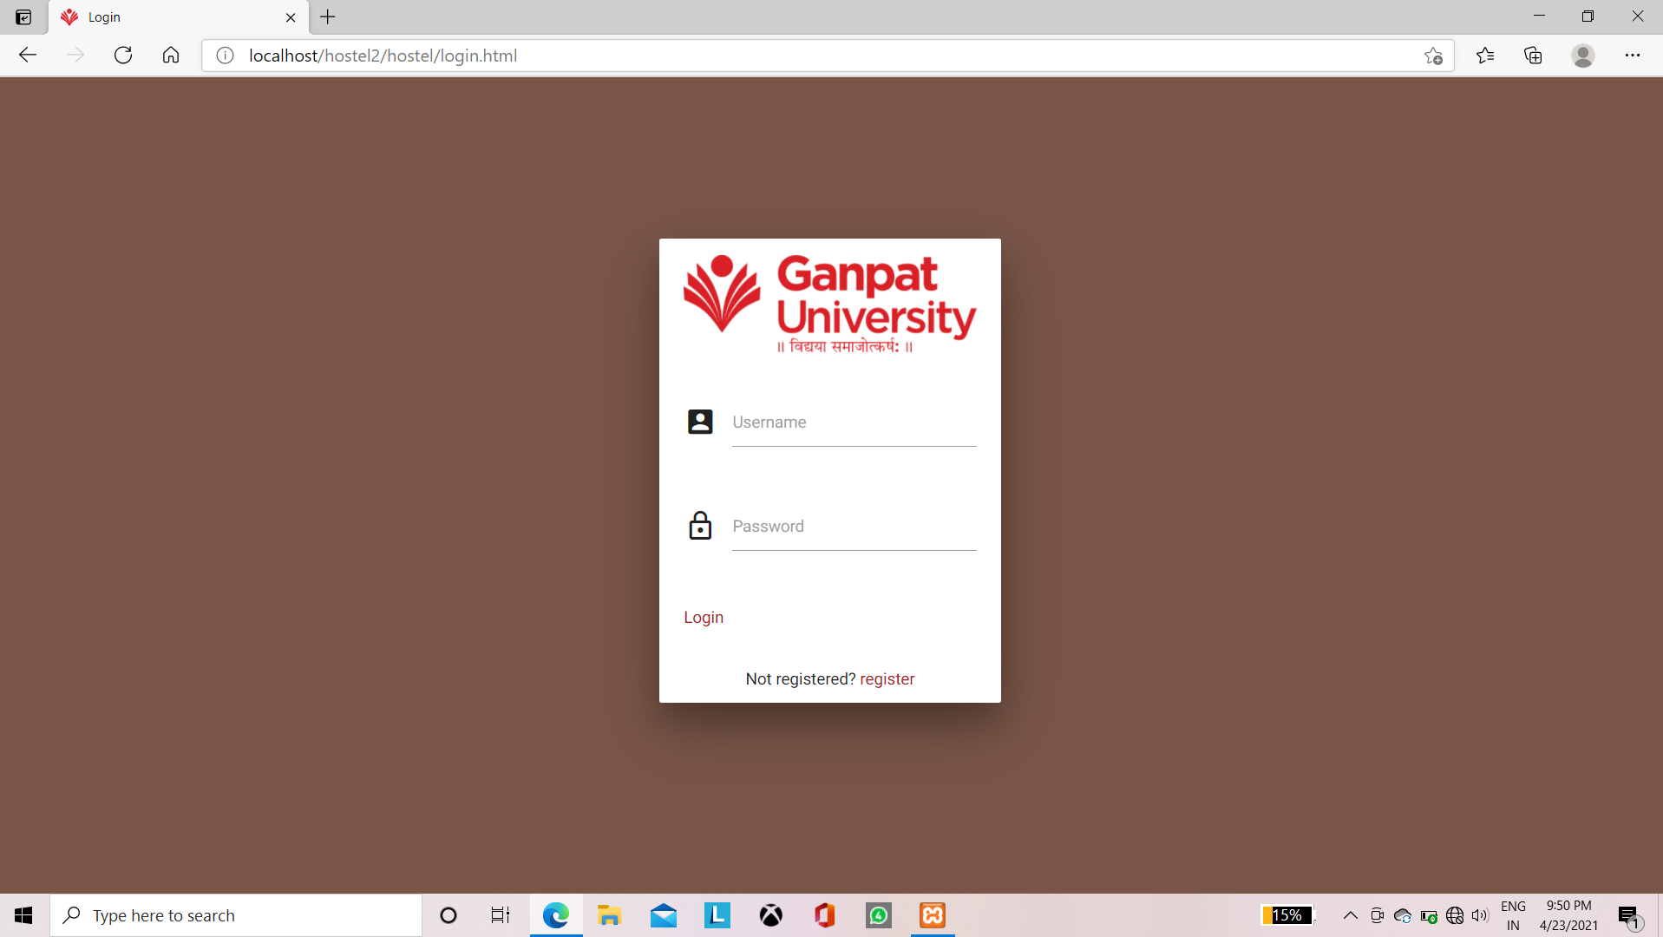
DESIGN IMPLEMENTATION
Design implementation refers to there alive running of the designed program. This section consists of the program modules, showing what they represent, and how the system can be deployed.
Login page

Slide 15
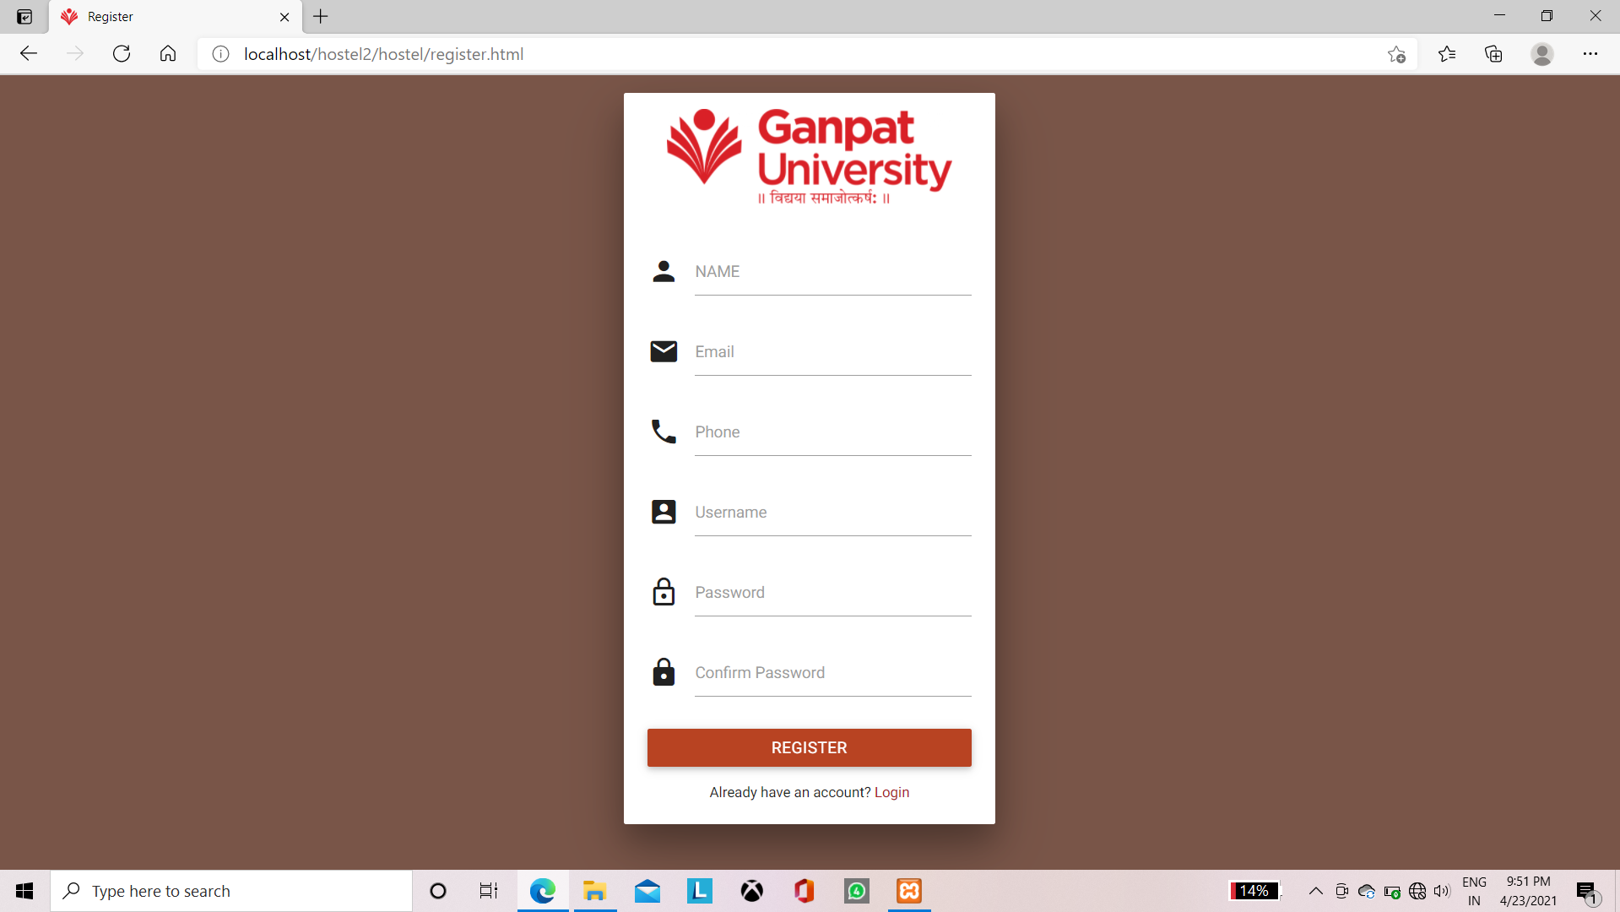
Registration page

Slide 16
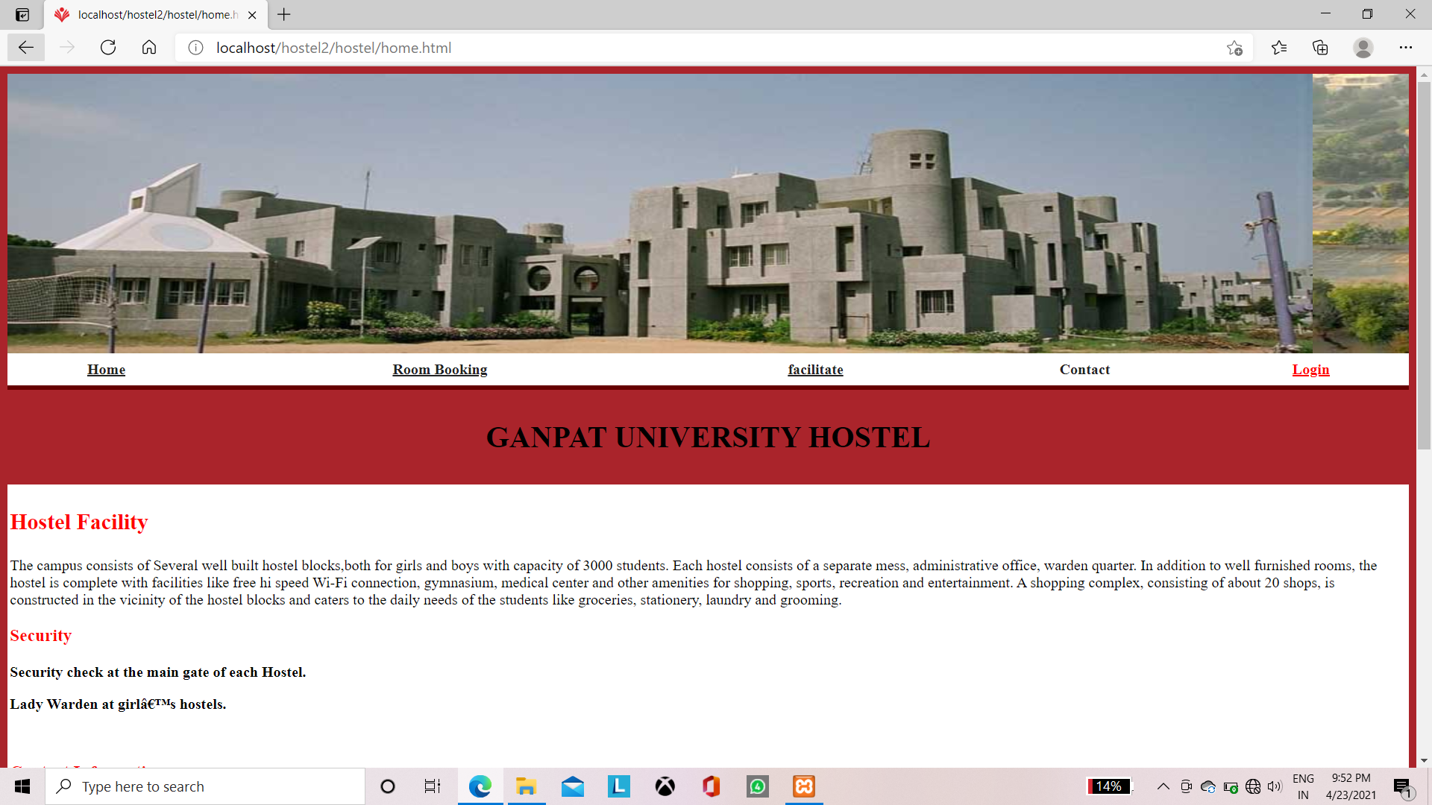
Home page

Slide 17
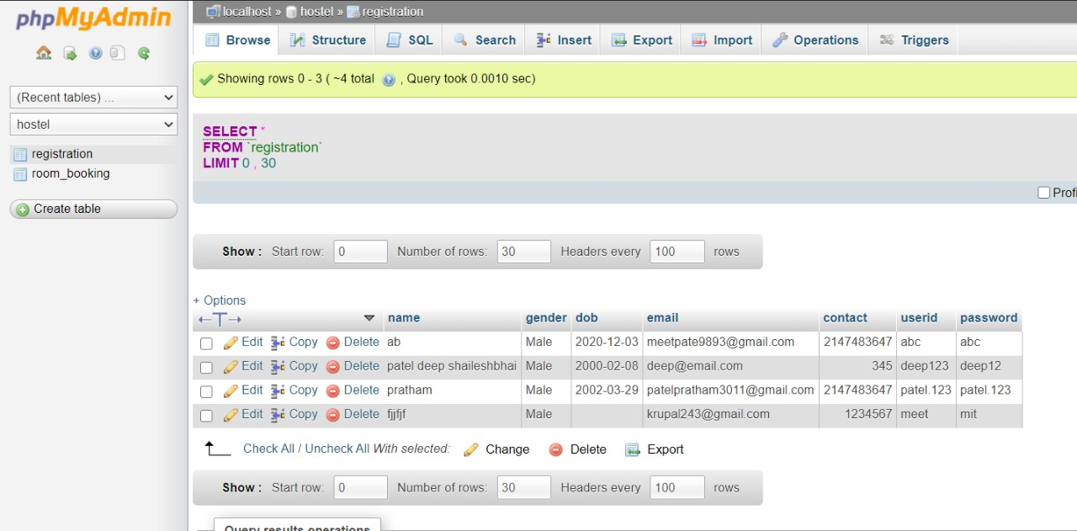
Database

Slide 18
Conclusion
The project Hostel management system is for computerizing the working in a school/ college hostels.
The website takecare for the requirement of registration and is capable to provide easy and effective storage of information related student that come up to the hostels.

Slide 19
Thank You

